Slide 1

Parkinson's disease diagnoses prediction by biomedical voice measurements

Slide 2
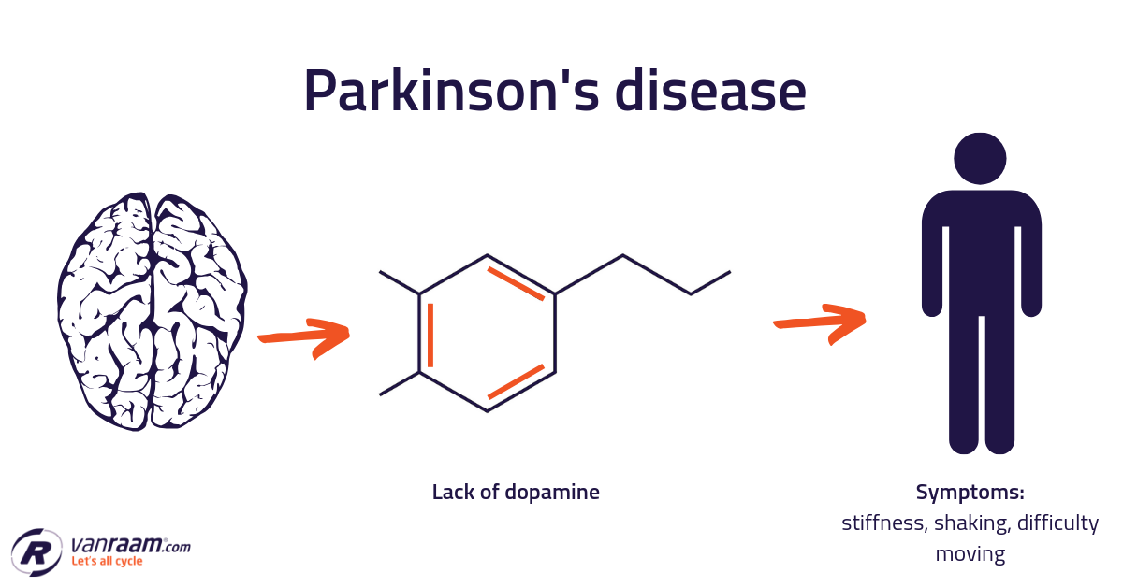
Info
Parkinson's disease is a degenerative disorder of the central nervous system.
This study aims to predict the clinician's Parkinson's disease symptom score on the Unified Parkinson's Disease Rating Scale (UPDRS) scale

Slide 3



Celebrity Disease

Slide 4
Why?
Predict motor and total UPDRS scores (Unified Parkinson Disease Rating Scale) by only daily voice notes
Enhances prediction accuracy for diagnosing PD
Reduce time and efforts for the patient and physician in the PD interview
Reduce the budget of PD existing diagnosis method .

Slide 5
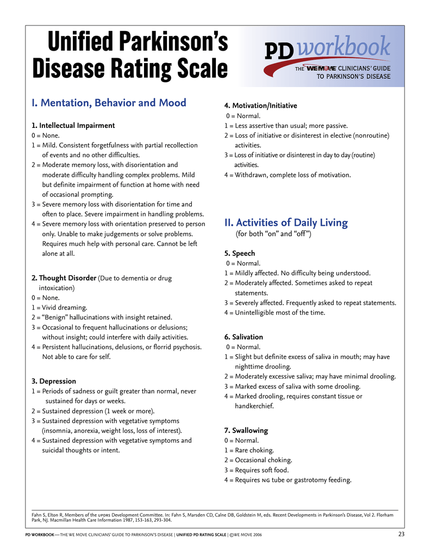

Slide 6
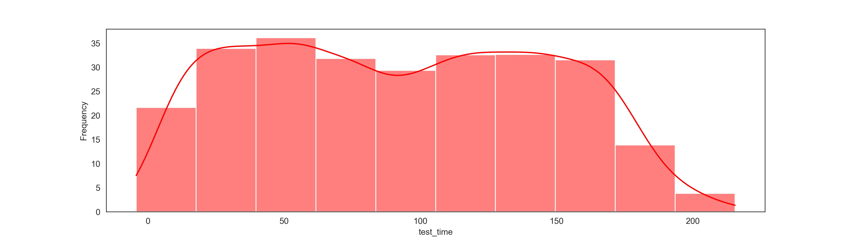
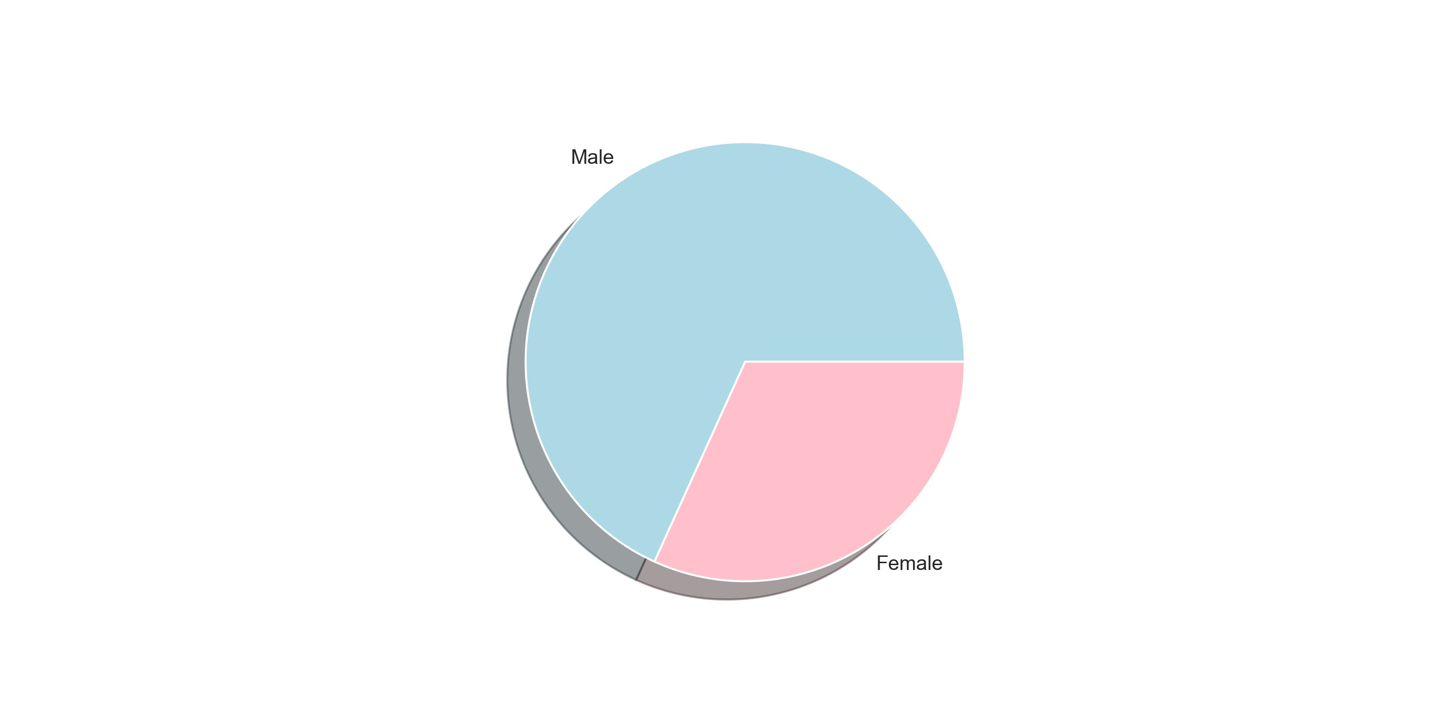
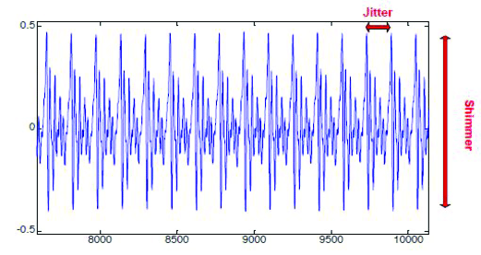
Data set
6 monthes
42 subjects
5,875 voices recording

Slide 7
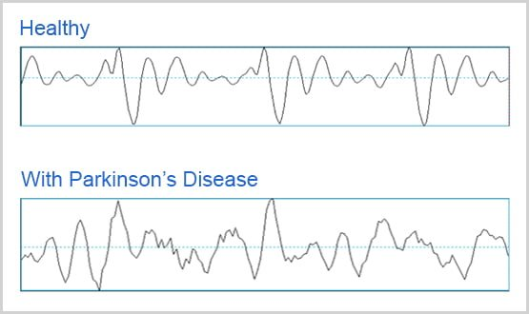

Slide 8
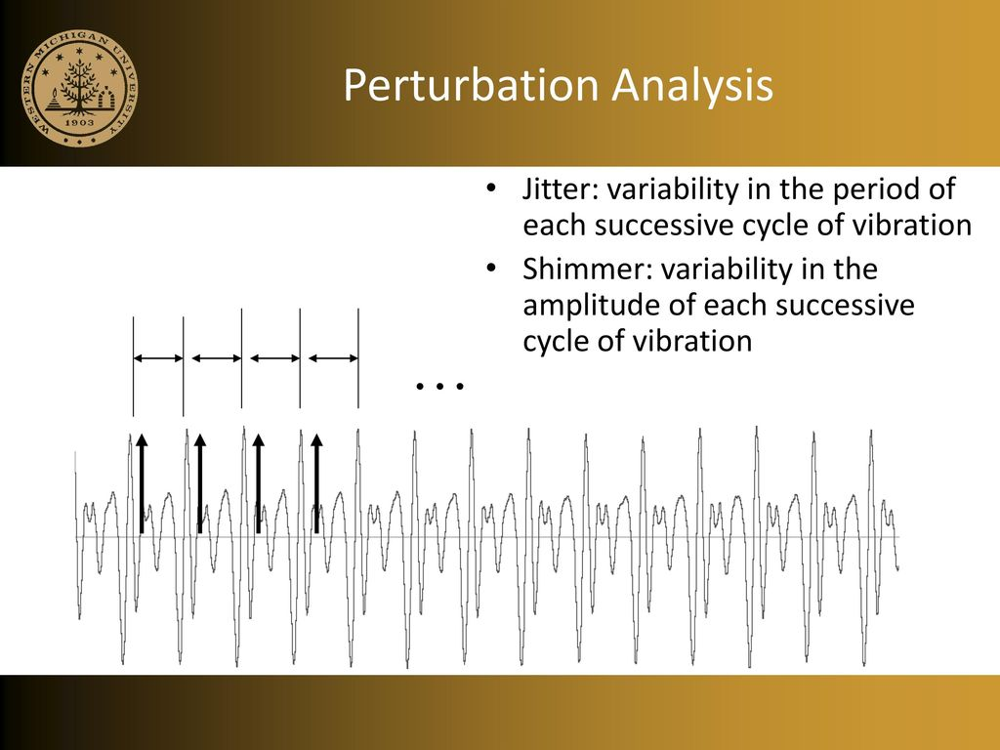
biomedical voice measurements

Slide 9
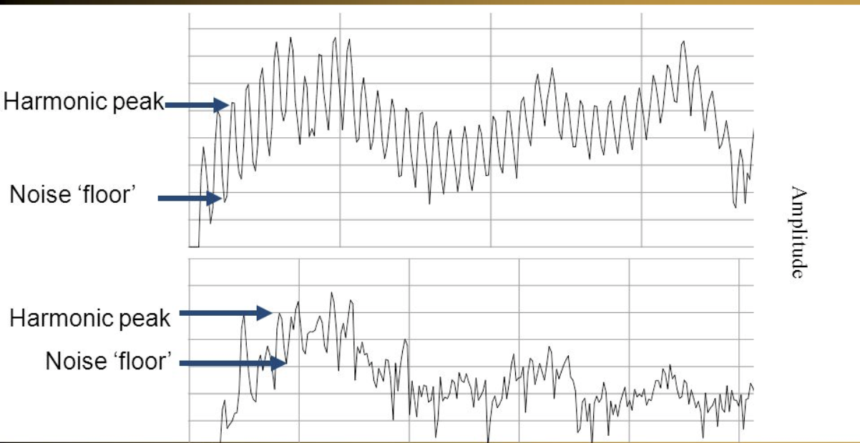
biomedical voice measurements
NHR,HNR - Two measures of ratio of noise to tonal components in the voice

Slide 10
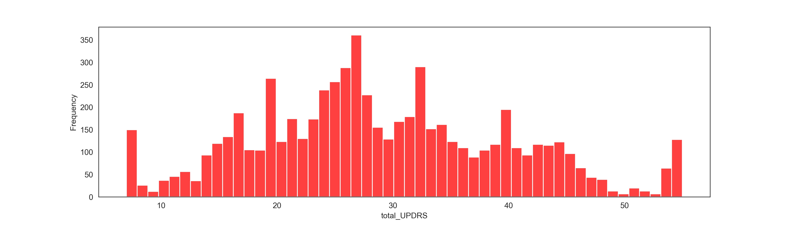
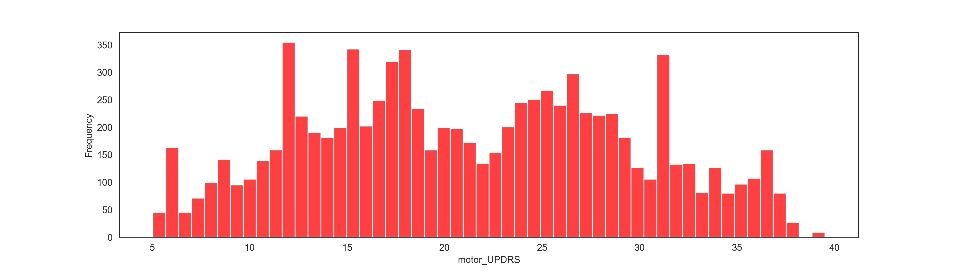
EDA
First : predict total_UPDRS
Second: predict motor_UPDRS

Slide 11
Validation
total_UPDRS | CV
Random Forest | 0.9947006277140272 0.96663381124561
motor_UPDRS | CV
Random Forest | 0.9951008710172824 0.9688578841227623

Slide 12
Methodology
total_UPDRS | R^2
Linear Regression | 0.8998843114883202
Random Forest | 0.9701640357375736
motor_UPDRS | R^2
Linear Regression | 0.8968838483541663
Random Forest | 0.9635582969759899

Slide 13
Future Work
Find more volunteer to participte in this study
Use more voice measurements to enhence the prediction
- Reach the Saudi Minstry of Health

Slide 14


